Slide 1
AgriOptima
Smart Farm Resource Optimization & Alert System
PL/SQL Capstone Project
Student: Rukundo Espoir (ID: 27678)
Lecturer: Eric Maniraquha
Date: November 17, 2025
Institution: Adventist University of Central Africa (AUCA)

Slide 2

The Challenge: Inefficient Farm Resource Management
Manual Allocation
Delayed Response
Leads to over-application of water, fertilizer, and pesticides, causing waste and increased costs.
Slow reaction to crop stress results in reduced yield and quality.
Poor Tracking
Inefficient inventory tracking causes operational downtime and supply chain issues.

Slide 3
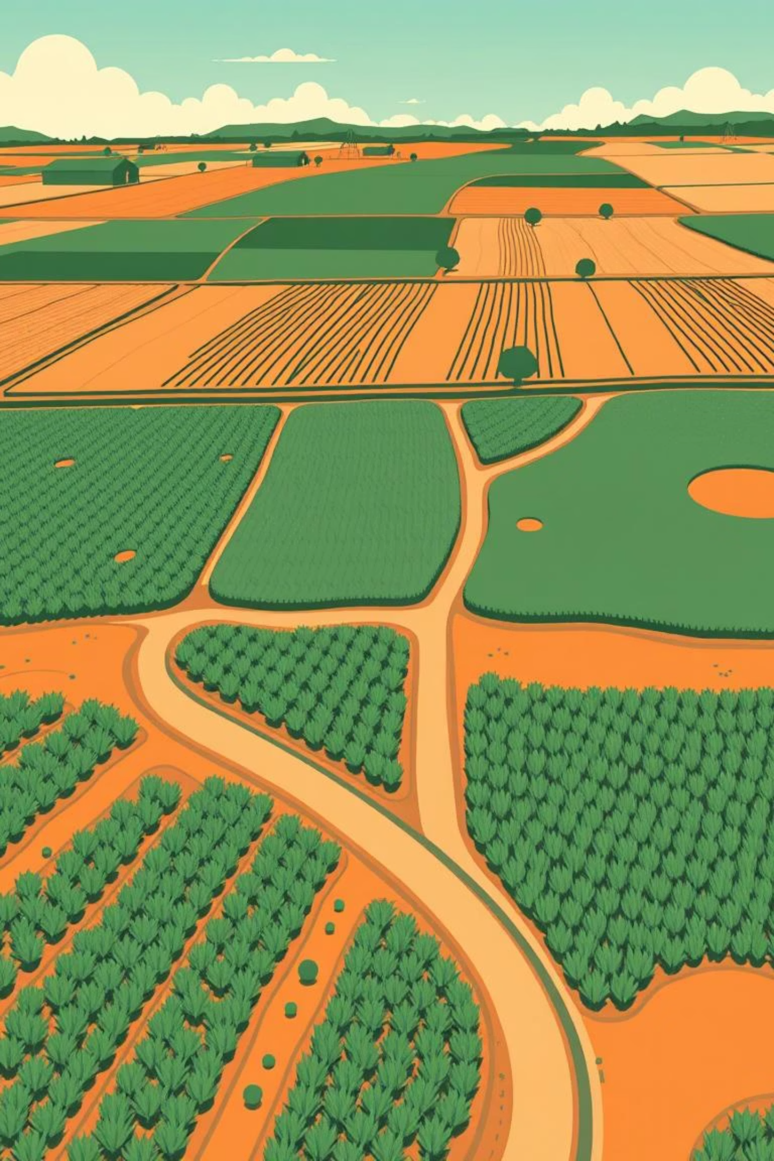



Impacts of Inefficiency
Reduced Profitability
Environmental Harm
Wasteful practices directly impact the farm's bottom line.
Over-application of chemicals damages ecosystems and soil health.
Operational Inefficiency
Lack of real-time data and alerts hinders smooth farm operations.

Slide 4
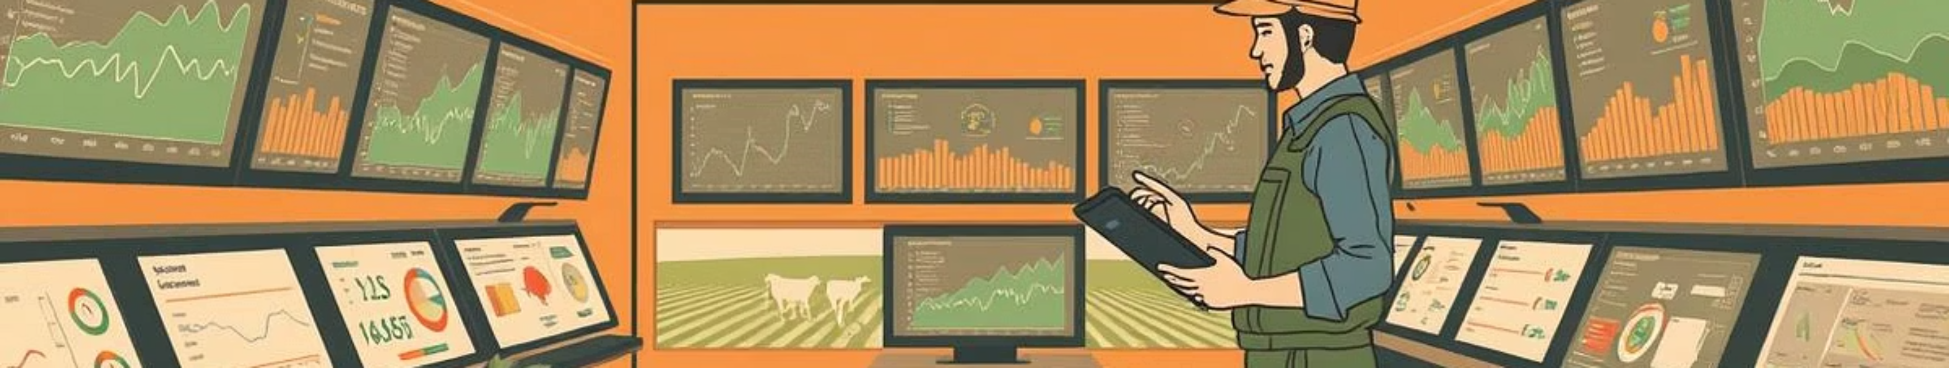
AgriOptima: System Context & Users
Where & How It's Used
Target Users
Context: Small to medium-scale farms, greenhouse operations.
Farmers & Agronomists: For daily decision-making.
Farm Managers: For resource planning & inventory control.
Environment: Integrated with IoT sensors (soil moisture, nutrient levels).
Agricultural Consultants: For analytics & reporting.
Database: Oracle-based backend with PL/SQL automation engine.

Slide 5
Project Goals
Automate Allocation
1
Using PL/SQL procedures for efficient resource distribution.
Minimize Waste
2
Through precision calculations for water, fertilizer, and pesticides.
Real-time Alerts
3
For stock shortages and environmental anomalies.
Improve Yield
4
With data-driven insights and predictive models.
Ensure Scalability
5
For future enhancements and growth.

Slide 6


Expected Outcomes
30%
100%
100%
Resource Waste Reduction
Proactive Management
Enhanced Decision-Making
Significant decrease in water, fertilizer, and pesticide usage.
Automated alerts enable timely responses to critical issues.
Through comprehensive Business Intelligence dashboards.

Slide 7
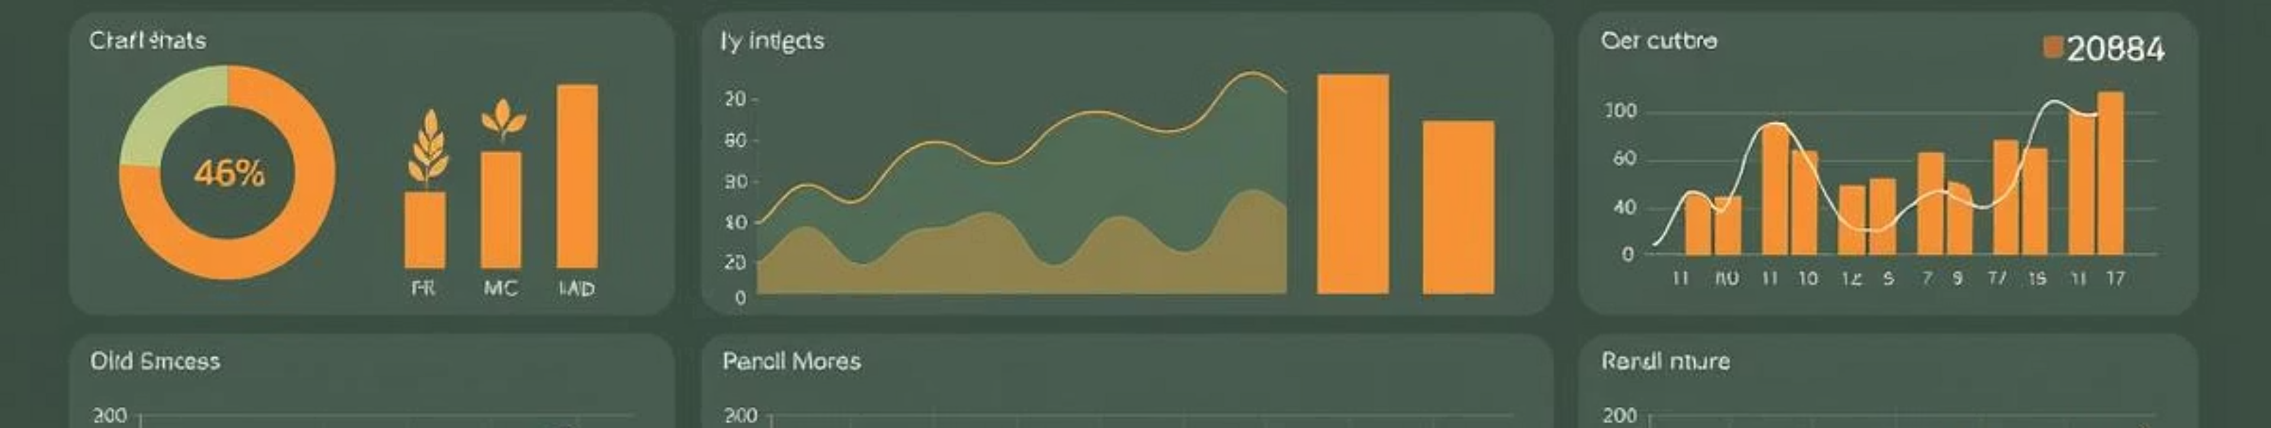




Business Intelligence Potential
How Analytics Enhance Decision-Making
Resource Efficiency Trends
Yield Forecasting
Track water and fertilizer usage over time for optimization.
Predictive models based on historical sensor data.
Alert Frequency & Type
Inventory Turnover
Identify recurring issues and address root causes.
Optimize reorder points for farm supplies.

Slide 8
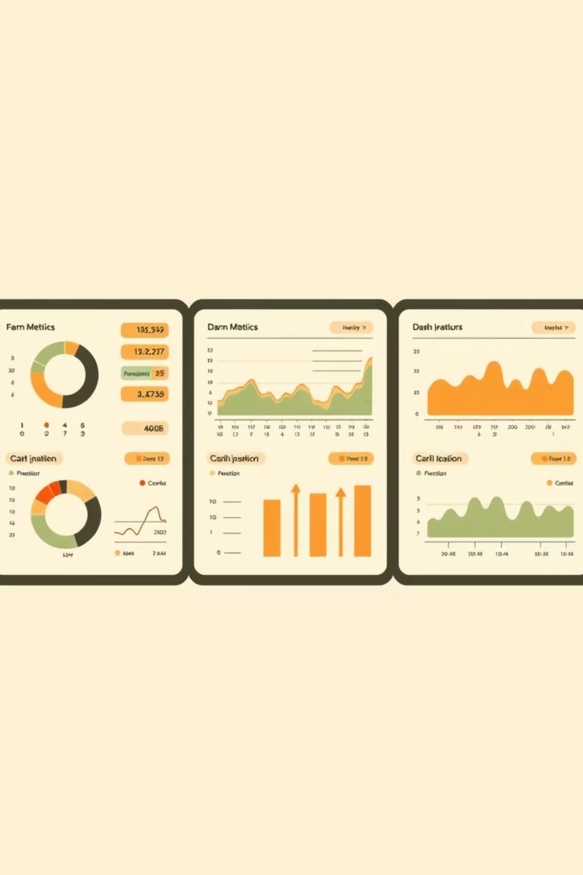
Planned BI Dashboards
Executive Summary
Audit Dashboard
Key Performance Indicator (KPI) cards for resource saved, alerts, and yield.
Monitor security violations and user activity for compliance.
Performance Dashboard
Compare actual resource usage against forecasted plans.

Slide 9




Decision Support with AgriOptima
When to Reorder
Predictive stock alerts ensure timely replenishment.
Where to Allocate
Priority-based resource distribution for optimal growth.
How to Improve
Historical trend analysis guides continuous optimization.

Slide 10


AgriOptima: The Future of Farming
AgriOptima empowers farmers with the tools to achieve greater efficiency, sustainability, and profitability.
Join us in cultivating a smarter, more productive agricultural future.

